Slide 1
CoVid-19
LESSON 3: Screening, Testing, and the CARES ACT
Find Press it to turn red when you aren’t talking.
Have a paper and pencil ready to use
HEALTH LITERACY WORK GROUP

Slide 2
Screening and Testing? Juanita’s Dilemma
Juanita is still not feeling well. She has been at home for three days and she still feels terrible. She has been monitoring her symptoms. Her temperature has been above 102 degrees for 3 days. She is still coughing and she gets short of breath when she walks around. But she is breathing OK when she lays down. Are Juanita’s symptoms mild, moderate, or severe?Her doctor says she should just continue to rest and hydrate.
Juanita heard that Bronson hospital and the health department are both doing COVID-19 testing. Shouldn’t she be tested? She has the symptoms! She decides to go to their websites.
Juanita finds some words she doesn’t know. Let’s take a look.

Slide 3
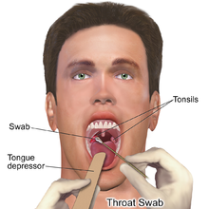
Some new medical words (we can read them together)
Screening: an interview where someone asks new patients questions to see what kind of care or testing they need. They help them find what the patient needs.
Care Advisor: A nurse or other medical person who asks screening questions.
Video Visit: an appointment with a health provider that is on your phone or computer with a video so you can see each other.
http://www.scorpiogenius.com
CC-EY-NC-ND/
CoVid 19 testing: Testing cells from a person’s nose or mouth to see if they have the virus
geobrava.wordpress.com cc-BY-SA-4.0

Slide 4
Matching
CoVid 19 testing:
Care Advisor
Screening
Video Visit
A nurse or other medical person who asks screening questions.
Looking at cells from a person’s nose or mouth to see if that person has the virus
An appointment with a health provider that is on your phone or computer with a video so you can see each other
An interview where someone asks the patient questions to see what kind of care or testing they need.

Slide 5
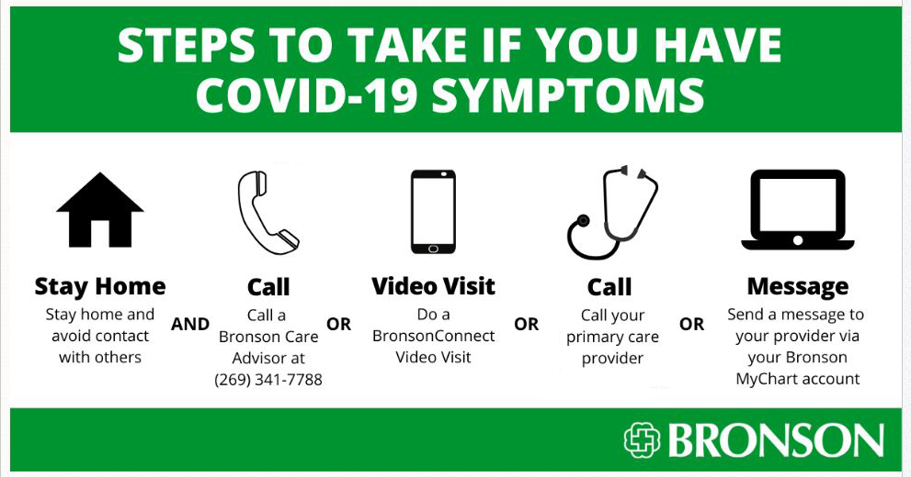
This is what Juanita found on Bronson’s website: How does the word “or” convince her that she doesn’t need to call a care advisor?

Slide 6
Juanita decides that since she already talked to her doctor she shouldn’t call a care advisor.
But, she remembers that the health department also has testing so she goes to their website. https://www.cdc.gov/coronavirus/2019-ncov/downloads/priority-testing-patients.pdf . She finds some words she doesn’t understand. She looks up the words.
Let’s see what she found

Slide 7
Words from the Health Department
Priority: a concern that comes before others and is acted on first
Healthcare-associated infections: Infections that are spread inside of a hospital:
Complications: When symptoms become severe or attack another part of your body
Underlying Conditions: Other sicknesses that a person has in their body like asthma or high blood pressure

Slide 8
Matching
Infections that are spread inside of a hospital
Other sicknesses that a person has in their body like asthma or high blood pressure
When symptoms become severe or attack another part of your body
a concern that comes before others and is acted on first
Priority:
Healthcare-associated infections:
Complications:
Underlying Conditions:

Slide 9
What does Juanita find out about testing?
Juanita reads that you can only get tested if your Dr. sends you.
She also reads that getting testing doesn’t change what the treatment will be. She would still be at home unless her symptoms became severe
Testing is to protect health care workers when they care for patients with severe symptoms.
Testing can be helpful to know who should stay away from others but there aren’t enough tests to do that right now.

Slide 10
This is how Michigan decides who gets the tests:
PRIORITY 1: Test the following people to lessen the risk of healthcare-associated infections:
• Hospitalized patients • Healthcare facility workers with symptoms
PRIORITY 2: Test the following people to treat those with the highest risk of complications:
• Patients in long-term care facilities with symptoms • Patients 65 years of age and older with symptoms • Patients with underlying conditions with symptoms • First responders with symptoms

Slide 11
Screening and Testing? Juanita’s Dilemma
Juanita now knows that she doesn’t need to get tested to get better. So, she drinks some more water and goes to sleep
Her doctor is making decisions for her like other providers and hospitals. If there are more tests he will let her know.
She will take care of herself at home.

Slide 12
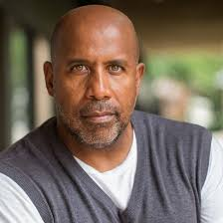
Frank’s Dilemma
Juanita’s husband, Frank, has been taking care of her while she has been sick. He has been able to sell car insurance from home and help Mary with her school work. But Frank’s boss called and said he will have to “furlough” Frank because he has been losing business because of the COVID-19 pandemic. Frank tells Juanita that he had to look up the word “furlough”. It means that he will not work or be paid but if things get better he can go back to work.
They are both worried about money. They have heard about the “stimulus” package. They decide to find out more about it. They go to their congressman, Fred Upton’s website and they find a booklet called the COVID-19 Resource Guide
https://upton.house.gov/uploadedfiles/uptoncoronavirusresourceguide_updateapril7.pdf.

Slide 13
The Guide Explains the Economic Stimulus Bill (called the Cares Act: Coronavirus Aid, Relief & Economic Security Act).
It also has links to websites for:
Internal revenue services
Unemployment
Where to get help with food
How to volunteer to help others

Slide 14
Juanita and Frank have to Learn some Legal Words
Economic security: having enough money and resources (like food and transportation)
Stimulus: something that makes a reaction
Distributed: given to people
Provisions: something for people to use

Slide 15
Matching
Economic security
something that makes a reaction
given to people
having enough money and resources
something for people to use
Stimulus
Distributed
Provisions

Slide 16
Other Legal Words
Benefit: an extra thing given to certain people
Qualifications: things that you have to have to get a benefit
Stoppage: the time when something stops
Enhanced: Extra, More than usual

Slide 17
Matching
Qualification:
An extra thing given to certain people
the time when something stops
things that you have to have to get a benefit.
Extra, more than usual
Benefit:
Stoppage:
Enhanced:

Slide 18
Frank and Juanita found two parts of the law that could help them
The Cares Act: Coronavirus Aid, Relief & Economic Security Act
Direct Financial Assistance for Individuals
Enhanced unemployment insurance

Slide 19
Direct Financial Assistance for Individuals: Economic Impact Payment
A check sent straight to your bank account from the internal revenue service of $1200 per adult and $500 per dependent child.
Qualifications (if you have these things you get the check):
You make under $75,000.
You filed a tax return for 2018 and/or 2019
You have a social security number
Nonresident aliens and undocumented workers do not qualify

Slide 20
Numbers Practice (let’s read them together)
$12, $120, $1200, $12,000
$5, $50, $500, $5,000
$75, $750, $7500, $75,000

Slide 21
Words and Numbers
$120
$12
$1200
$12,000
One thousand two hundred dollars
Twelve dollars
Twelve thousand dollars
One hundred and twenty dollars

Slide 22
Math for the Stimulus Check
Juanita and Frank make under $75,000. The law says they will get $1200 per adult and $500 per dependent child. How much will they get for their family (include their daughter, Mary) ______________
Juanita will get _________________
Frank will get ___________________
Mary will get ___________________
The whole family will get ______________

Slide 23
Math for the Stimulus Check
How much will Juanita’s mother get in her stimulus check? _____________
Will you get a check? Can you figure out how much for your family?
# of Adults X $1200= _____________
# of children X $500= _____________
total for family = ______________

Slide 24
Problems? https://www.irs.gov/coronavirus/economic-impact-payments

Slide 25
Juanita and Frank
Frank and Juanita are glad they will be getting a stimulus check but they know this won’t last them for long. Frank will look for a new job but he knows they need more money coming in. He decides to figure out unemployment. What is this “enhanced” unemployment?

Slide 26
Enhanced Unemployment Insurance
Frank’s furlough does qualify him to apply for unemployment. This is how the law enhanced unemployment benefits.
It adds $600/week to the usual amount for anyone getting unemployment
It adds an additional 13 weeks. You can get unemployment now for 39 weeks.
It will pay someone the benefits from the day of work stoppage even if it took awhile to apply
Important: After work stoppage you must apply within 28 days.

Slide 27
Applying for unemployment
Frank must file online through the Michigan Web Account manager https://www.michigan.gov/documents/uia/MiWAM_toolkit_for_Claimants_July_2019_662197_7.pdf
To apply he will need:
His social security number
His employment information for the past 18 months
His address, phone number, date of birth
His driver’s license or state ID
A non-citizens would need their alien registration and authorization card with the expiration date.

Slide 28
When to Apply for Michigan Unemployment

Slide 29
Juanita and Frank
Juanita and Frank feel better that they will be getting some money even though Frank is furloughed and Juanita is sick. Frank starts to work on his unemployment application right away and Juanita tells her mother about the check she will be getting soon!
What a relief!

Slide 30
Homework
Next week we will talk about how to be less nervous during the stay at home order. We will also discuss what else you want to learn about Covid-19. Write down ideas through the week and collect words that you want to know.
HEALTH LITERACY WORK GROUP

Slide 31
Stay Healthy!
Developed by:
Dr. Doris Ravotas
Fulbright Specialist
Master Faculty Specialist
School of Interdisciplinary Health Programs
College of Health and Human Services
KLC Fellow and Health Literacy Work Group Leader
Email: doris.ravotas@wmich.edu
HEALTH LITERACY WORK GROUP

Slide 32
References
Bronson health system. (2020). Coronavirus-19. Retrieved from https://www.bronsonhealth.com/coronavirus-covid-19/
Internal Revenue Services (2020). Economic Stimulus Payments. Retrieved from https://www.irs.gov/coronavirus/economic-impact-payments
CDC. (2020). Coronavirus. Retrieved from https://www.cdc.gov/coronavirus/2019-ncov/downloads/priority-testing-patients.pdf
Kalamazoo Department of Health and Human Services. (2020). CoVid-19. https://www.kalcounty.com/hcs/covid19.php
N.A. (2019). Care advisor (photograph). Retrieved from http://www.scorpiogenius.com.
.

Slide 33
References (cont.)
N.A. (2019). Video visit (image). Retrieved from https://www.geobrava.wordpress.com
N.A. (2017). Nasal Testing (image). Retrieved from https://en.wikipedia.org/wiki/Tonsillitis
N.A. (2014) Stoppage (image). Retrieved from https://en.wikipedia.org/wiki/File:Stop.png.
State of Michigan (2019). Tookit for Claimants. Retrieved from
https://www.michigan.gov/documents/uia/MiWAM_toolkit_for_Claimants_July_2019_662197_7.pdf
Upton, F. (2020). The Coronavirus Resource Guide. Retireved from https://upton.house.gov/uploadedfiles/uptoncoronavirusresourceguide_updateapril7.pdf.

